Slide 1
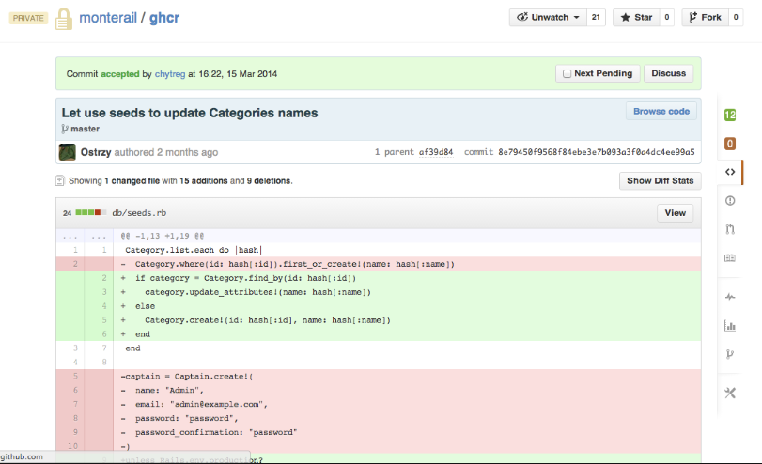
CI/CD
Version control
Git, svn ect
Branches
Code Reviews

Slide 2
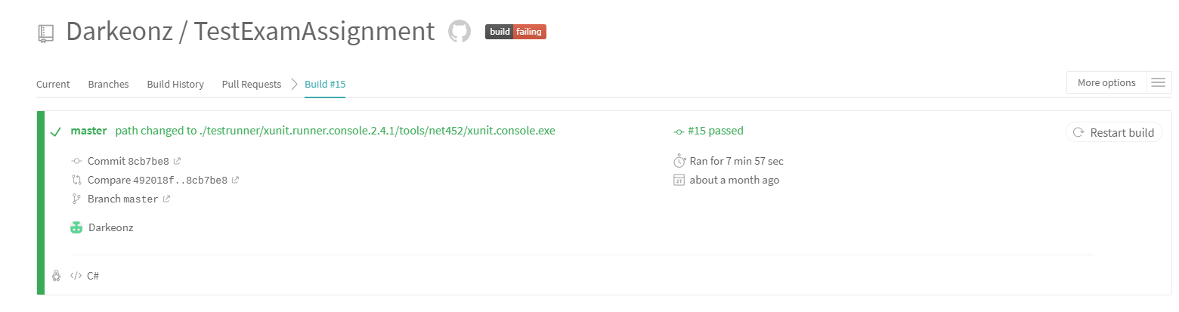
CI/CD
Test automation
Environments
Builds
Deployment

